Slide 1
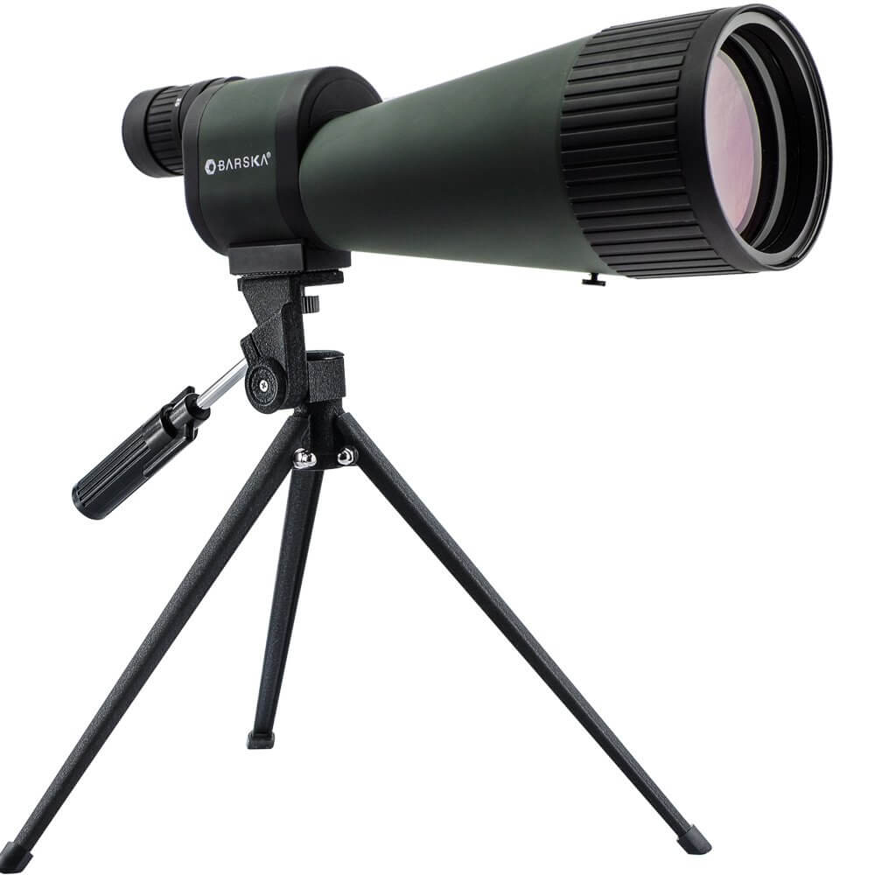
Functions + Scope

Slide 2
What is a function in Python?
Types of Functions
Defining a Function:
Defining a function without any parameters
Defining a function without parameters and return value
Defining a function with parameters
Defining a function with parameters and return value
Passing Arguments with Key and Value
How to call a function in python?
Docstrings
Global, Local Variables

Slide 3
Functions
Why functions?
Maximize code reuse and minimize redundancy
Procedural decomposition
Break bit task into smaller tasks
Makes code less buggy – can test each function individually

Slide 4
Types of Functions
Python support two types of functions
Built-in function
User-defined function
1.Built-in function
The functions which are come along with Python itself are called a built-in function or predefined function. Some of them are: range(), print(), input(), type(), id(), eval() etc.
Example: Python range() function generates the immutable sequence of numbers starting from the given start integer to the stop integer.
>>> for i in range(1, 10):
>>> print(i, end=' ')
1 2 3 4 5 6 7 8 9

Slide 5
User-defined function
Functions which are created by programmer explicitly according to the requirement are called a user-defined function.
Syntax:
def function_name(parameter1, parameter2):
"""docstring"""
# function body
# write some action
return value

Slide 6
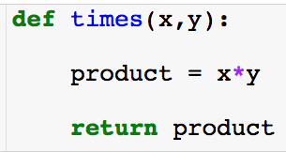
Functions
Create function (required)
Function inputs: here there are two and order matters. (optional)
Object that function gives back. (optional)

Slide 7
Functions
Create function (required)
Function inputs: here there are two and order matters. (optional)
Inside the function (local scope)
Object that function gives back. (optional)
The code inside the function is never executed unless you call the function!

Slide 8
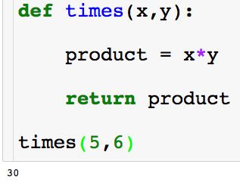
Functions
To call a function type the name and give the inputs required.

Slide 9
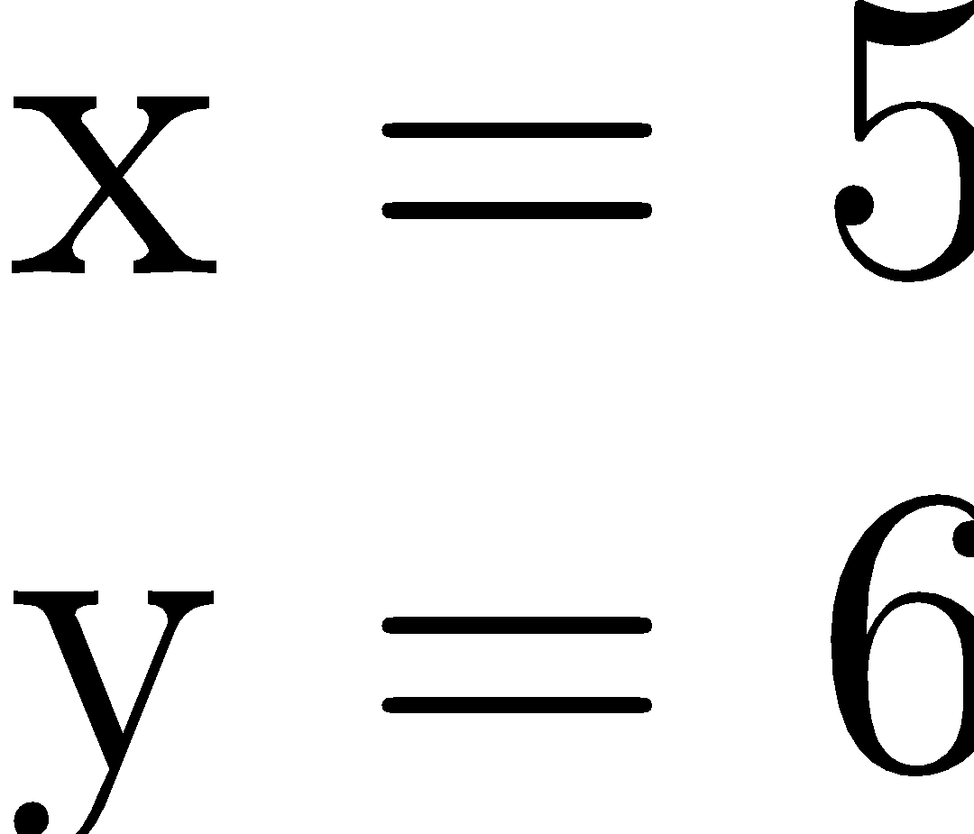
Functions
To call a function type the name and give the inputs required.

Slide 10
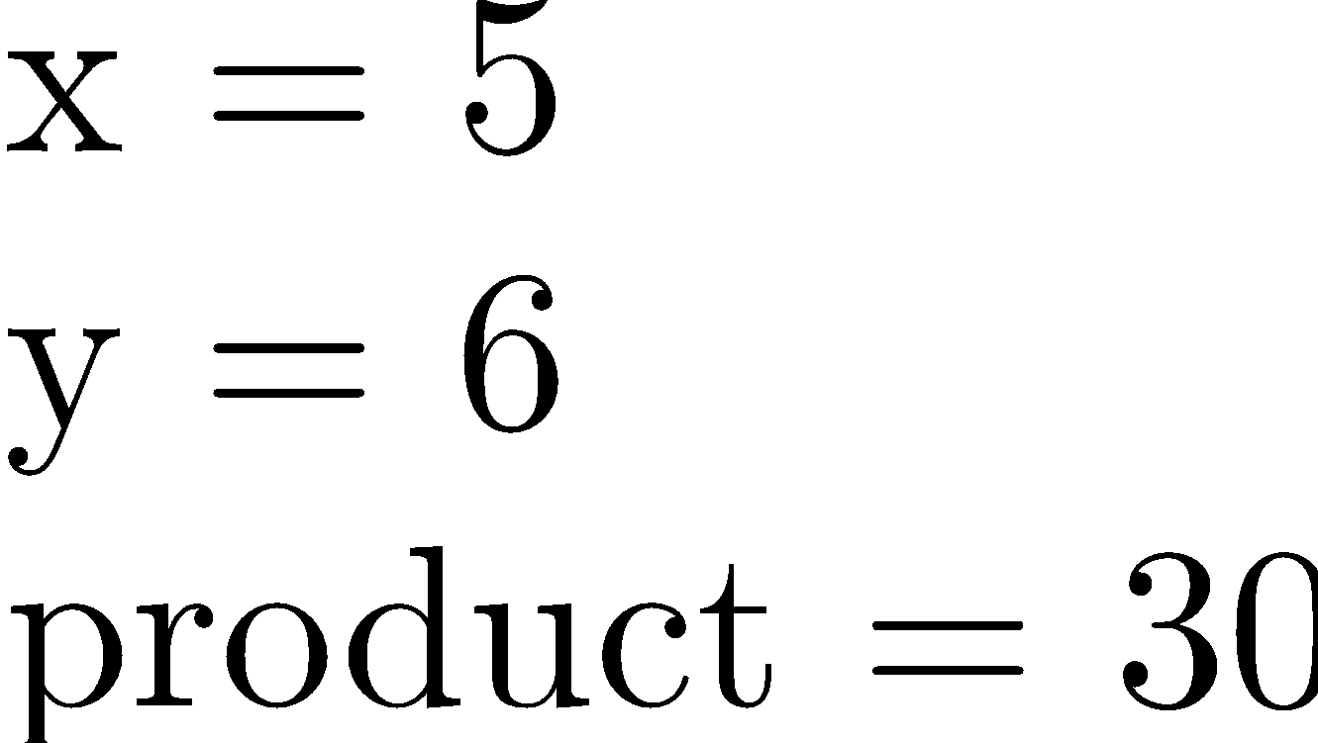
Functions
To call a function type the name and give the inputs required.

Slide 11
Functions
To call a function type the name and give the inputs required.

Slide 12
Functions
To call a function type the name and give the inputs required.

Slide 13
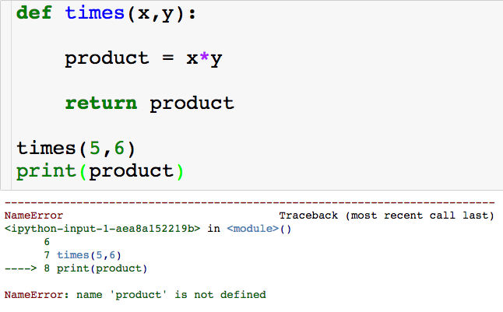
Functions
The variables product doesn’t exist outside of the function…but we can store the object returned by the function!

Slide 14
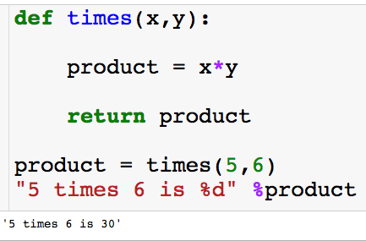
Functions
We can store the result returned from the function in a variables

Slide 15
Functions
We can store the result returned from the function in a variables

Slide 16
Functions
We can store the result returned from the function in a variables

Slide 17
Functions
We can store the result returned from the function in a variables

Slide 18
Functions
We can store the result returned from the function in a variables
We did not have to name this variable product, we could have names it anything.

Slide 19
Functions
We can store the result returned from the function in a variables

Slide 20
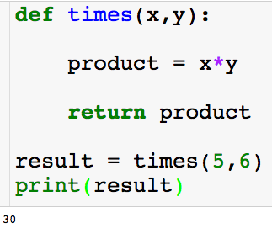
Functions
We can store the result returned from the function in a variables

Slide 21
Functions
We can store the result returned from the function in a variables
What will happen if I try to print product? Or x?

Slide 22
Functions
We can store the result returned from the function in a variables
What will happen if I try to print product? Or x?
Where does each variables “live”?

Slide 23
Scope
Python scopes are the places where variables are defined and looked up.
Local Scope
Variables created with a function, i.e., inside of a def.
Variables inside of a def will not clash with variables outside even if they have the same name.
Global Scope
Variable created outside of a function.

Slide 24
Scope
Python scopes are the places where variables are defined and looked up.
Local Scope
Variables created with a function, i.e., inside of a def.
Variables inside of a def will not clash with variables outside even if they have the same name.
Global Scope
Variable created outside of a function.
When outside of a function, python only sees variables in the global scope.

Slide 25
Scope
Python scopes are the places where variables are defined and looked up.
Local Scope
Variables created with a function, i.e., inside of a def.
Variables inside of a def will not clash with variables outside even if they have the same name.
Global Scope
Variable created outside of a function.
When inside of a function, python first searches the local scope and then searches the global.

Slide 26
Scope
Local scope:
Global scope:

Slide 27
Scope
Local scope:
Global scope:

Slide 28
Scope
Local scope:
Global scope:

Slide 29
Scope
Local scope:
Global scope:

Slide 30
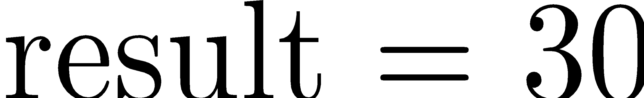
Scope
Local scope:
Global scope:

Slide 31
Scope
Local scope:
Global scope:

Slide 32
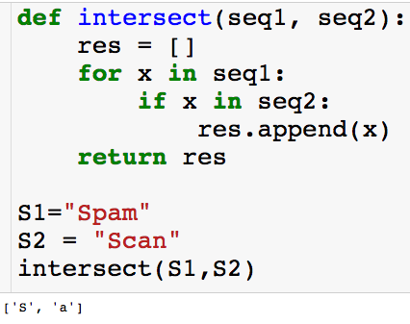
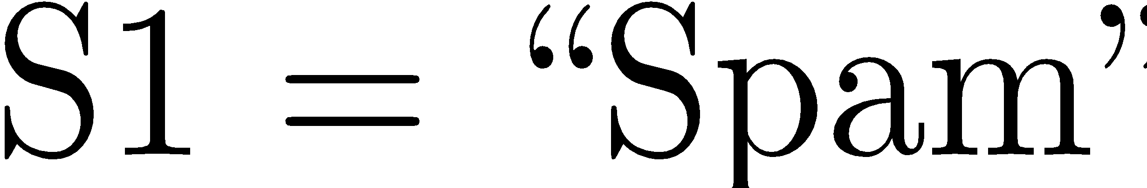
Scope
Local scope:
Global scope:

Slide 33
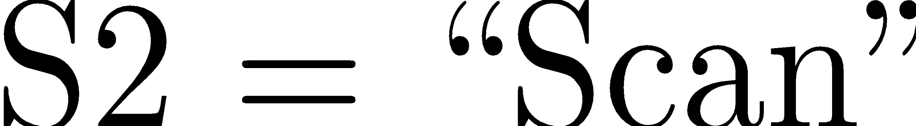
Scope
Local scope:
Global scope:

Slide 34
Scope
Local scope:
Global scope:

Slide 35
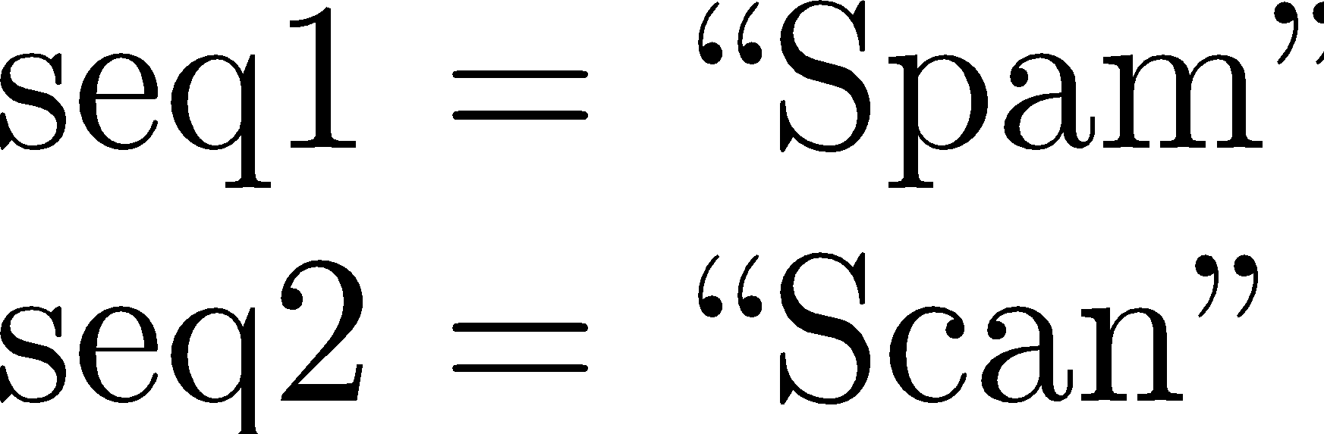
Scope
Local scope:
Global scope:

Slide 36
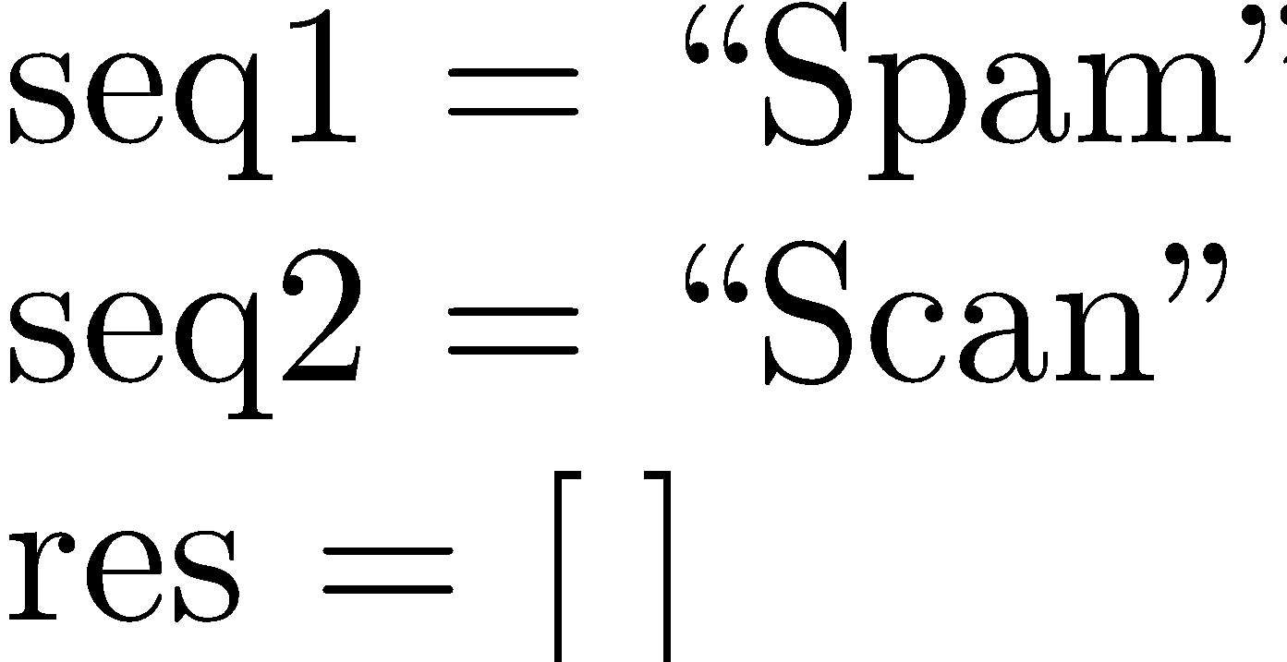
Scope
Local scope:
Global scope:

Slide 37
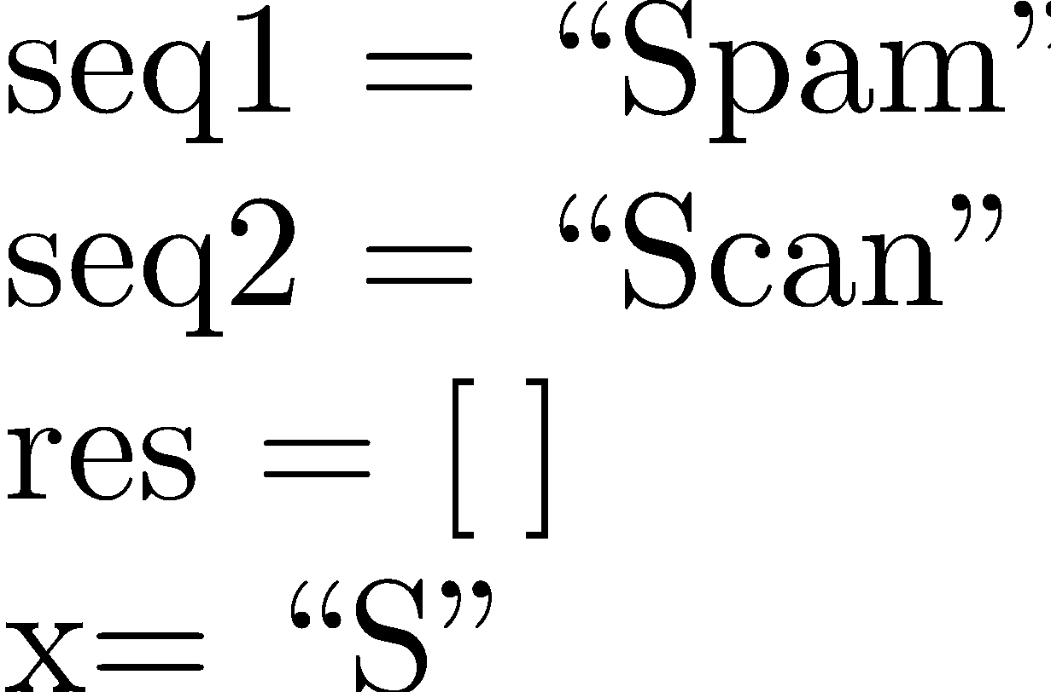
Scope
Local scope:
Global scope:

Slide 38
Scope
Local scope:
Global scope:

Slide 39
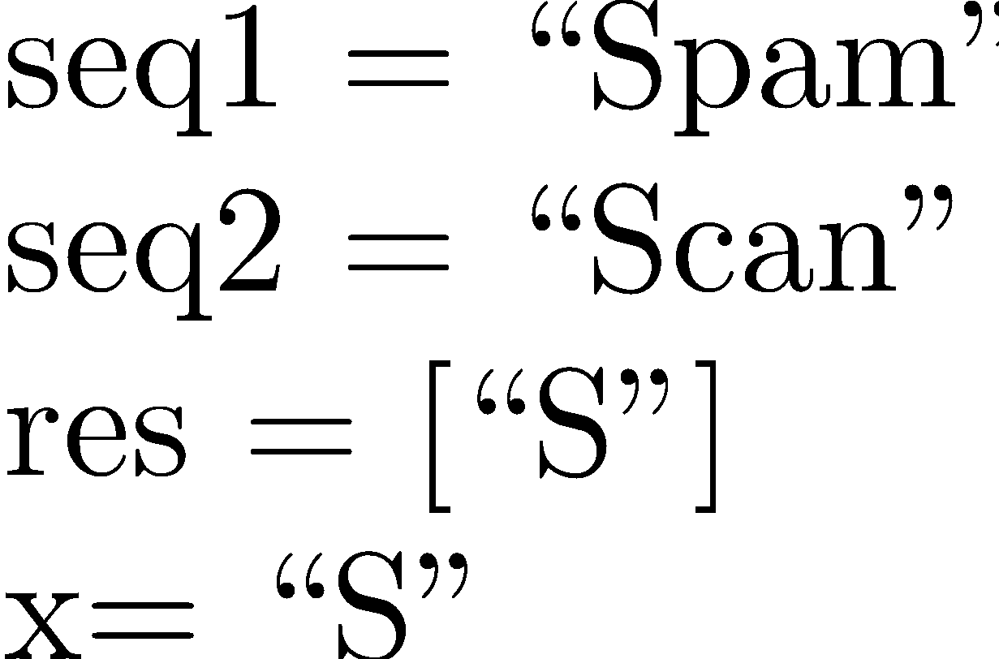
Scope
Local scope:
Global scope:

Slide 40
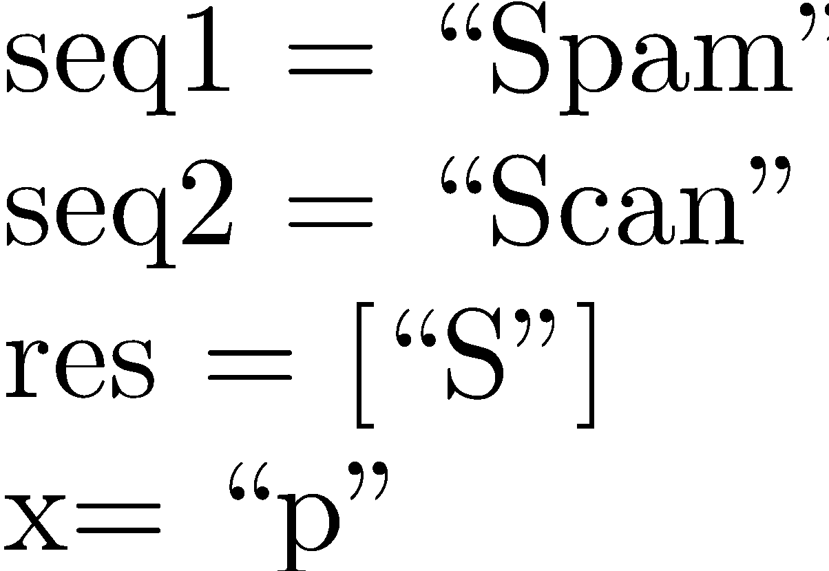
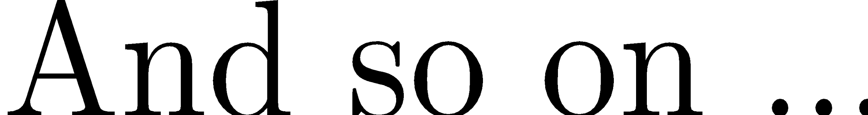
Scope
Local scope:
Global scope:

Slide 41
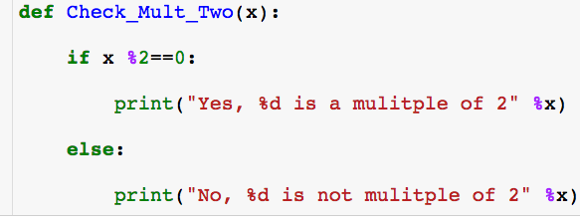

Stringing Functions Together

Slide 42
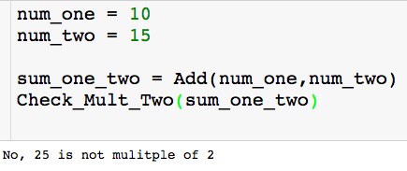
Stringing Functions Together

Slide 43
Stringing Functions Together

Slide 44
Stringing Functions Together

Slide 45
Stringing Functions Together

Slide 46
Stringing Functions Together

Slide 47
Stringing Functions Together

Slide 48
Stringing Functions Together

Slide 49
Stringing Functions Together

Slide 50
Nested Functions
Functions can call other functions!

Slide 51
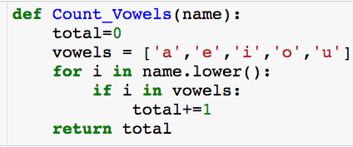
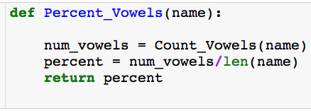
Nested Functions
Count number of vowels in name
Computes percentage of vowels in name

Slide 52

Nested Functions
Count number of vowels in name
Computes percentage of vowels in name

Slide 53
Nested Functions
Count number of vowels in name
Computes percentage of vowels in name

Slide 54
Nested Functions
Count number of vowels in name
Computes percentage of vowels in name

Slide 55
Nested Functions
Count number of vowels in name
Computes percentage of vowels in name

Slide 56
Nested Functions
Count number of vowels in name
Computes percentage of vowels in name

Slide 57
Nested Functions
Count number of vowels in name
Computes percentage of vowels in name

Slide 58
Nested Functions
Count number of vowels in name
Computes percentage of vowels in name

Slide 59
Nested Functions
Count number of vowels in name
Computes percentage of vowels in name

Slide 60

Nested Functions
Count number of vowels in name
Computes percentage of vowels in name

Slide 61
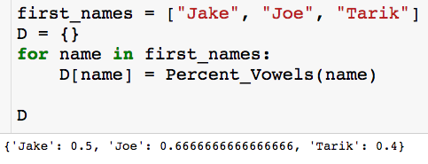
Nested Functions
Count number of vowels in name
Computes percentage of vowels in name

Slide 62
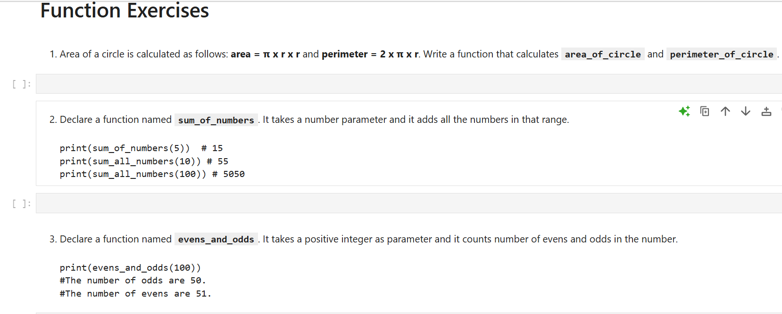

Slide 63
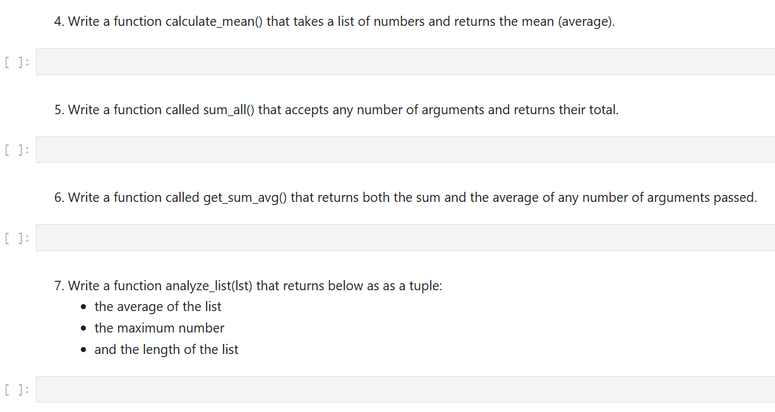

Slide 64
